Slide 1
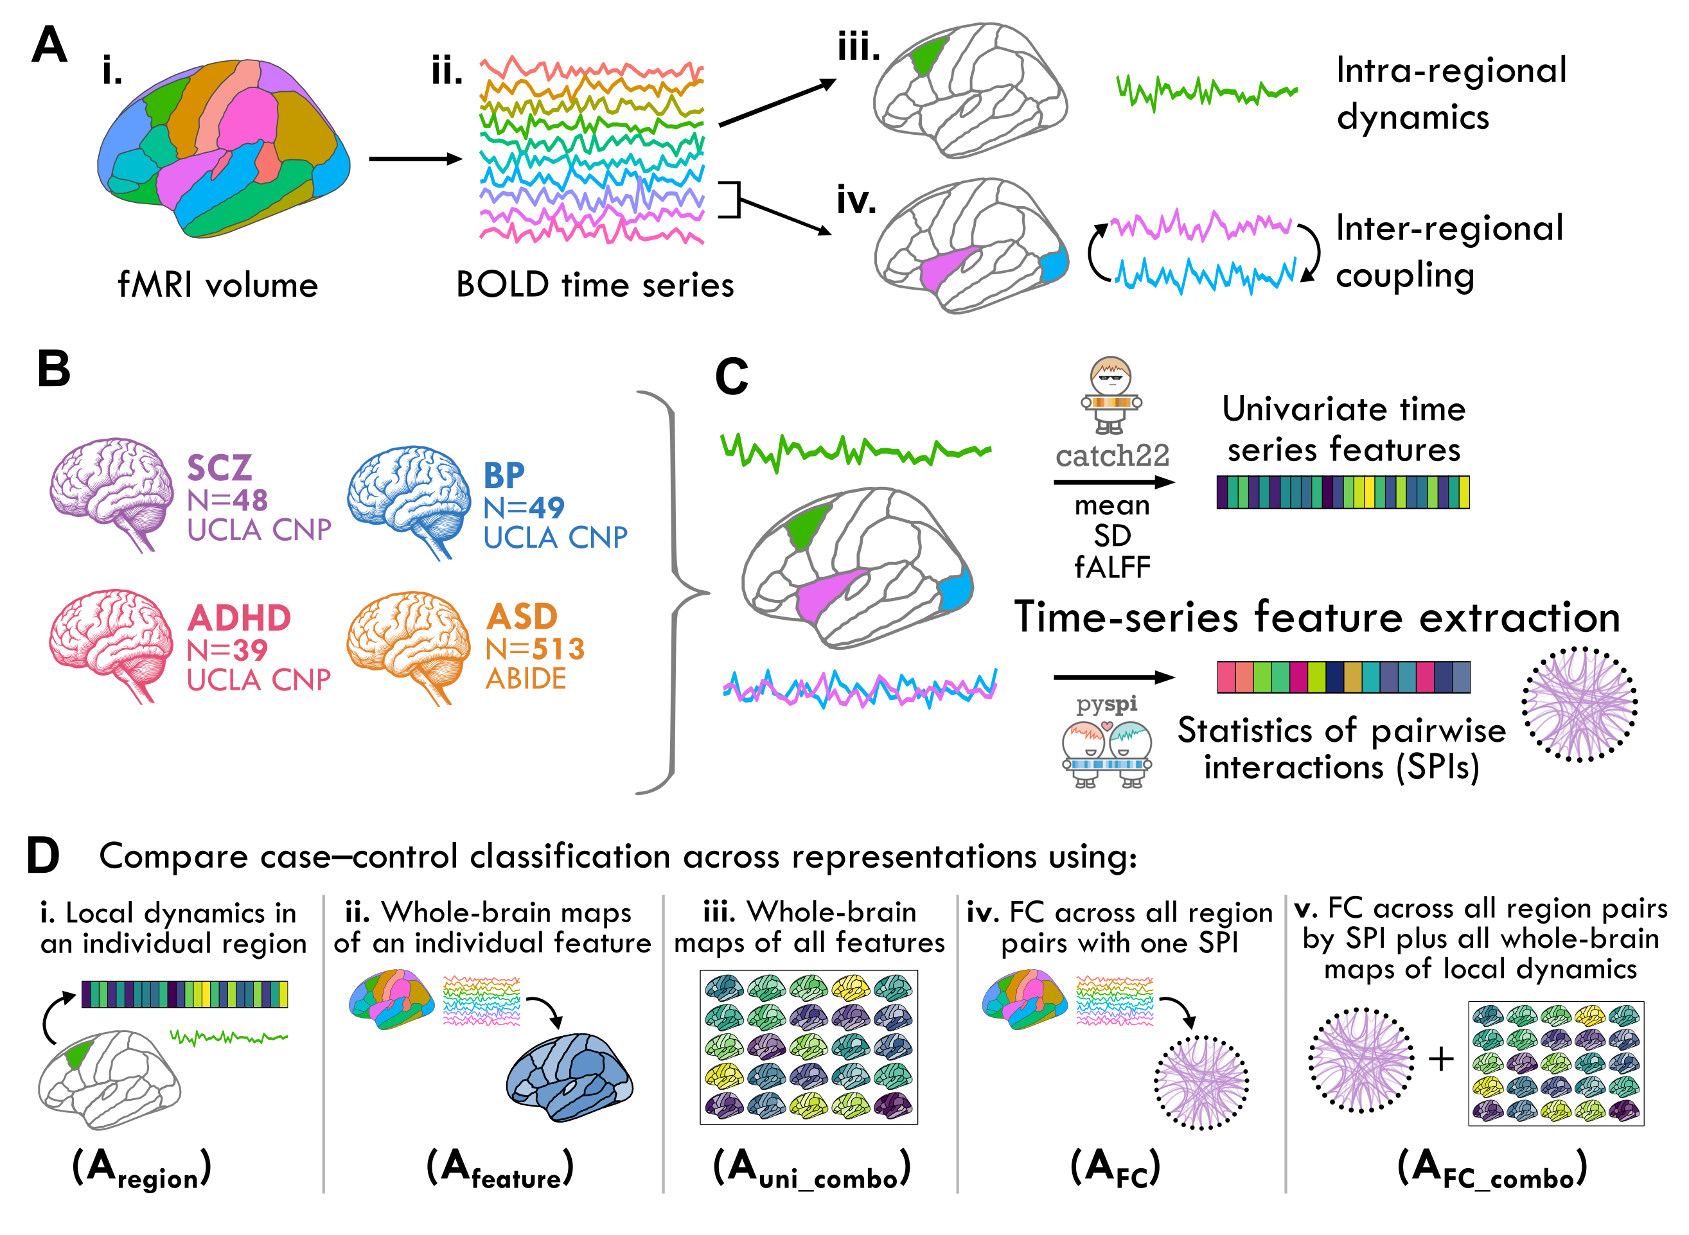
Fig 1

Slide 2
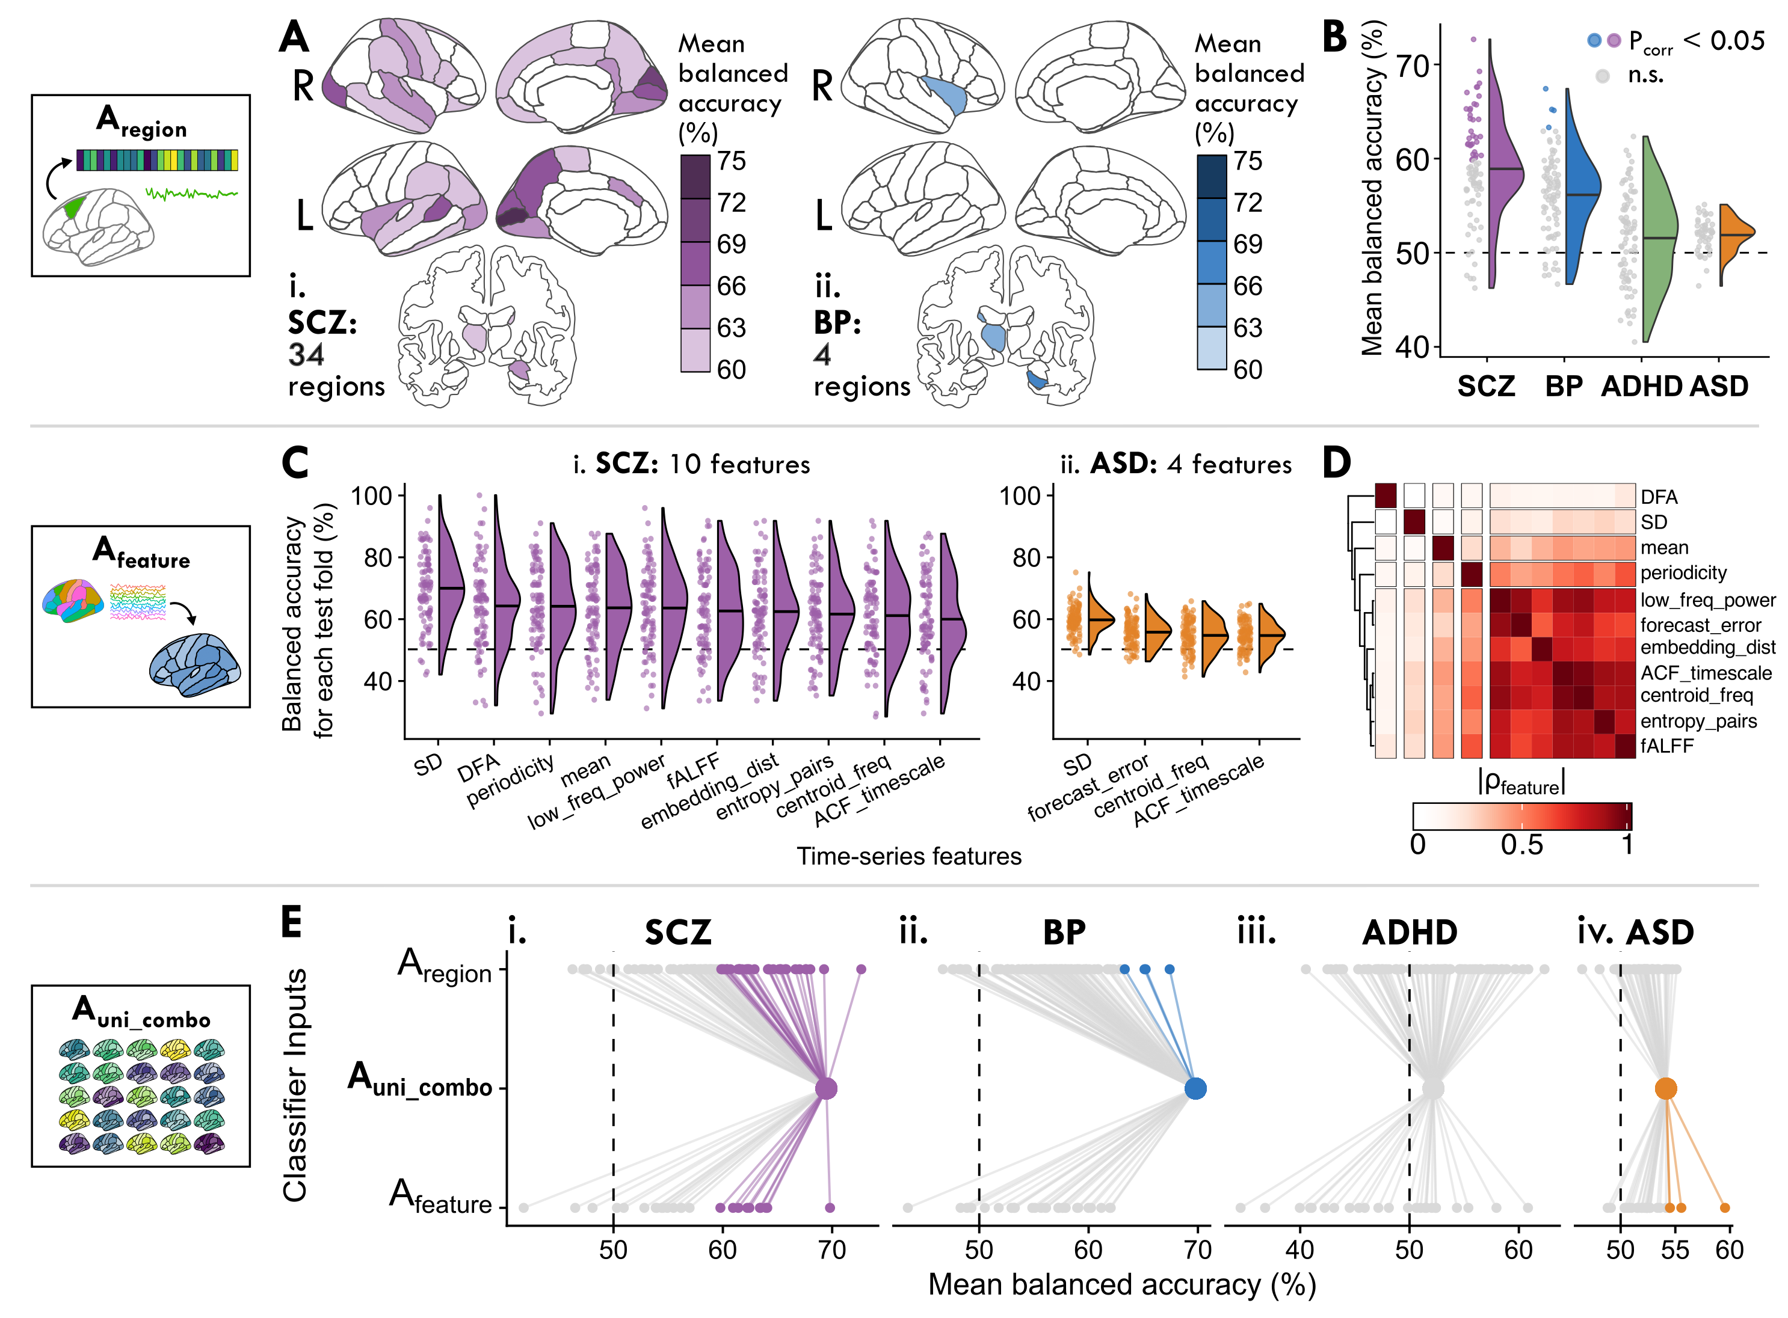
Fig 2

Slide 3
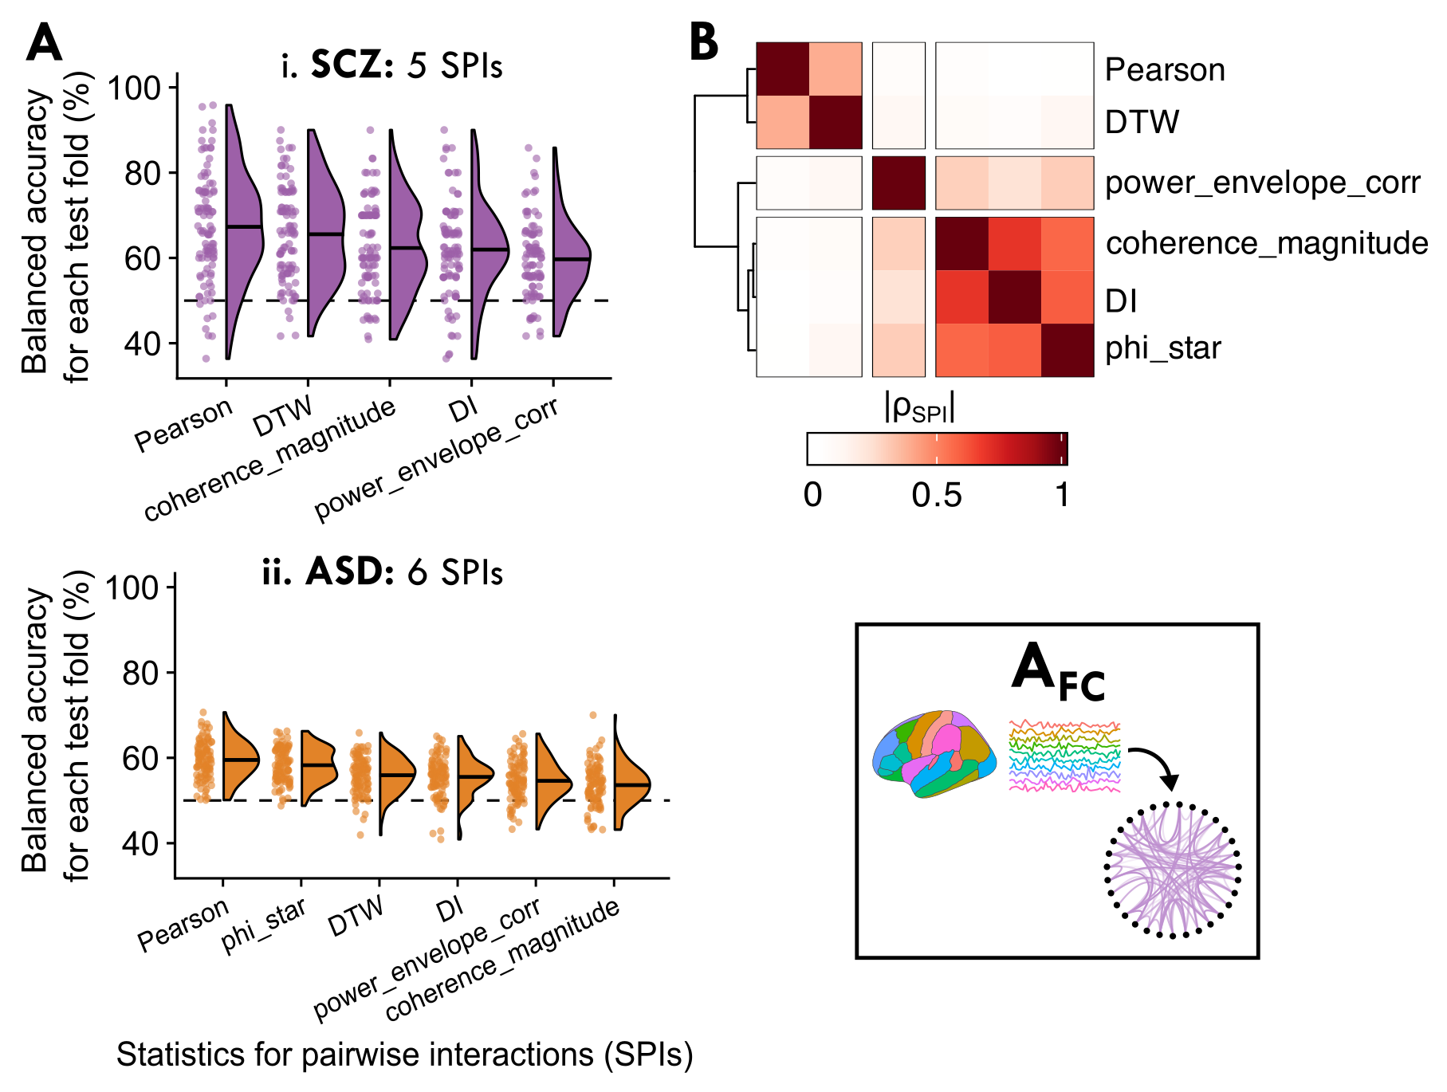
Fig 3

Slide 4
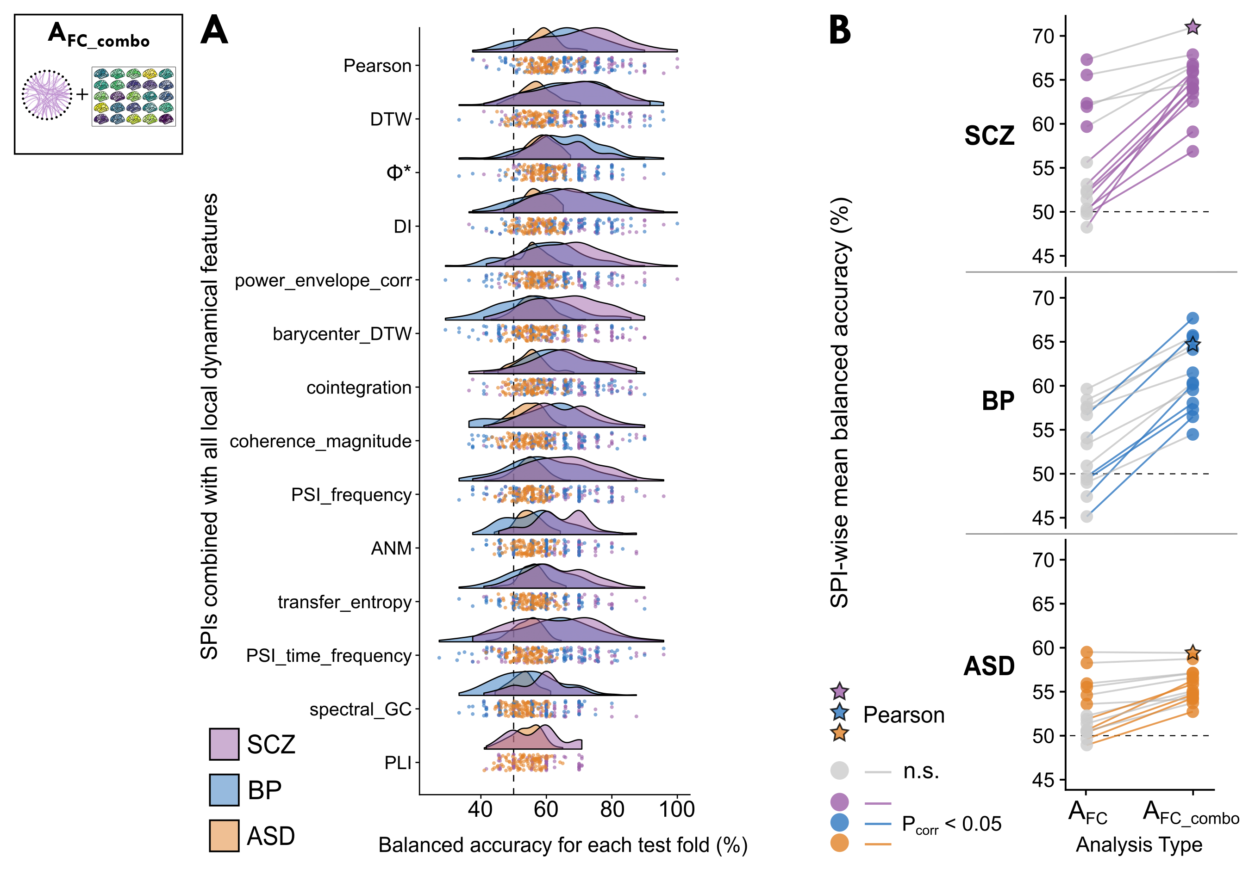
Fig 4

Slide 5
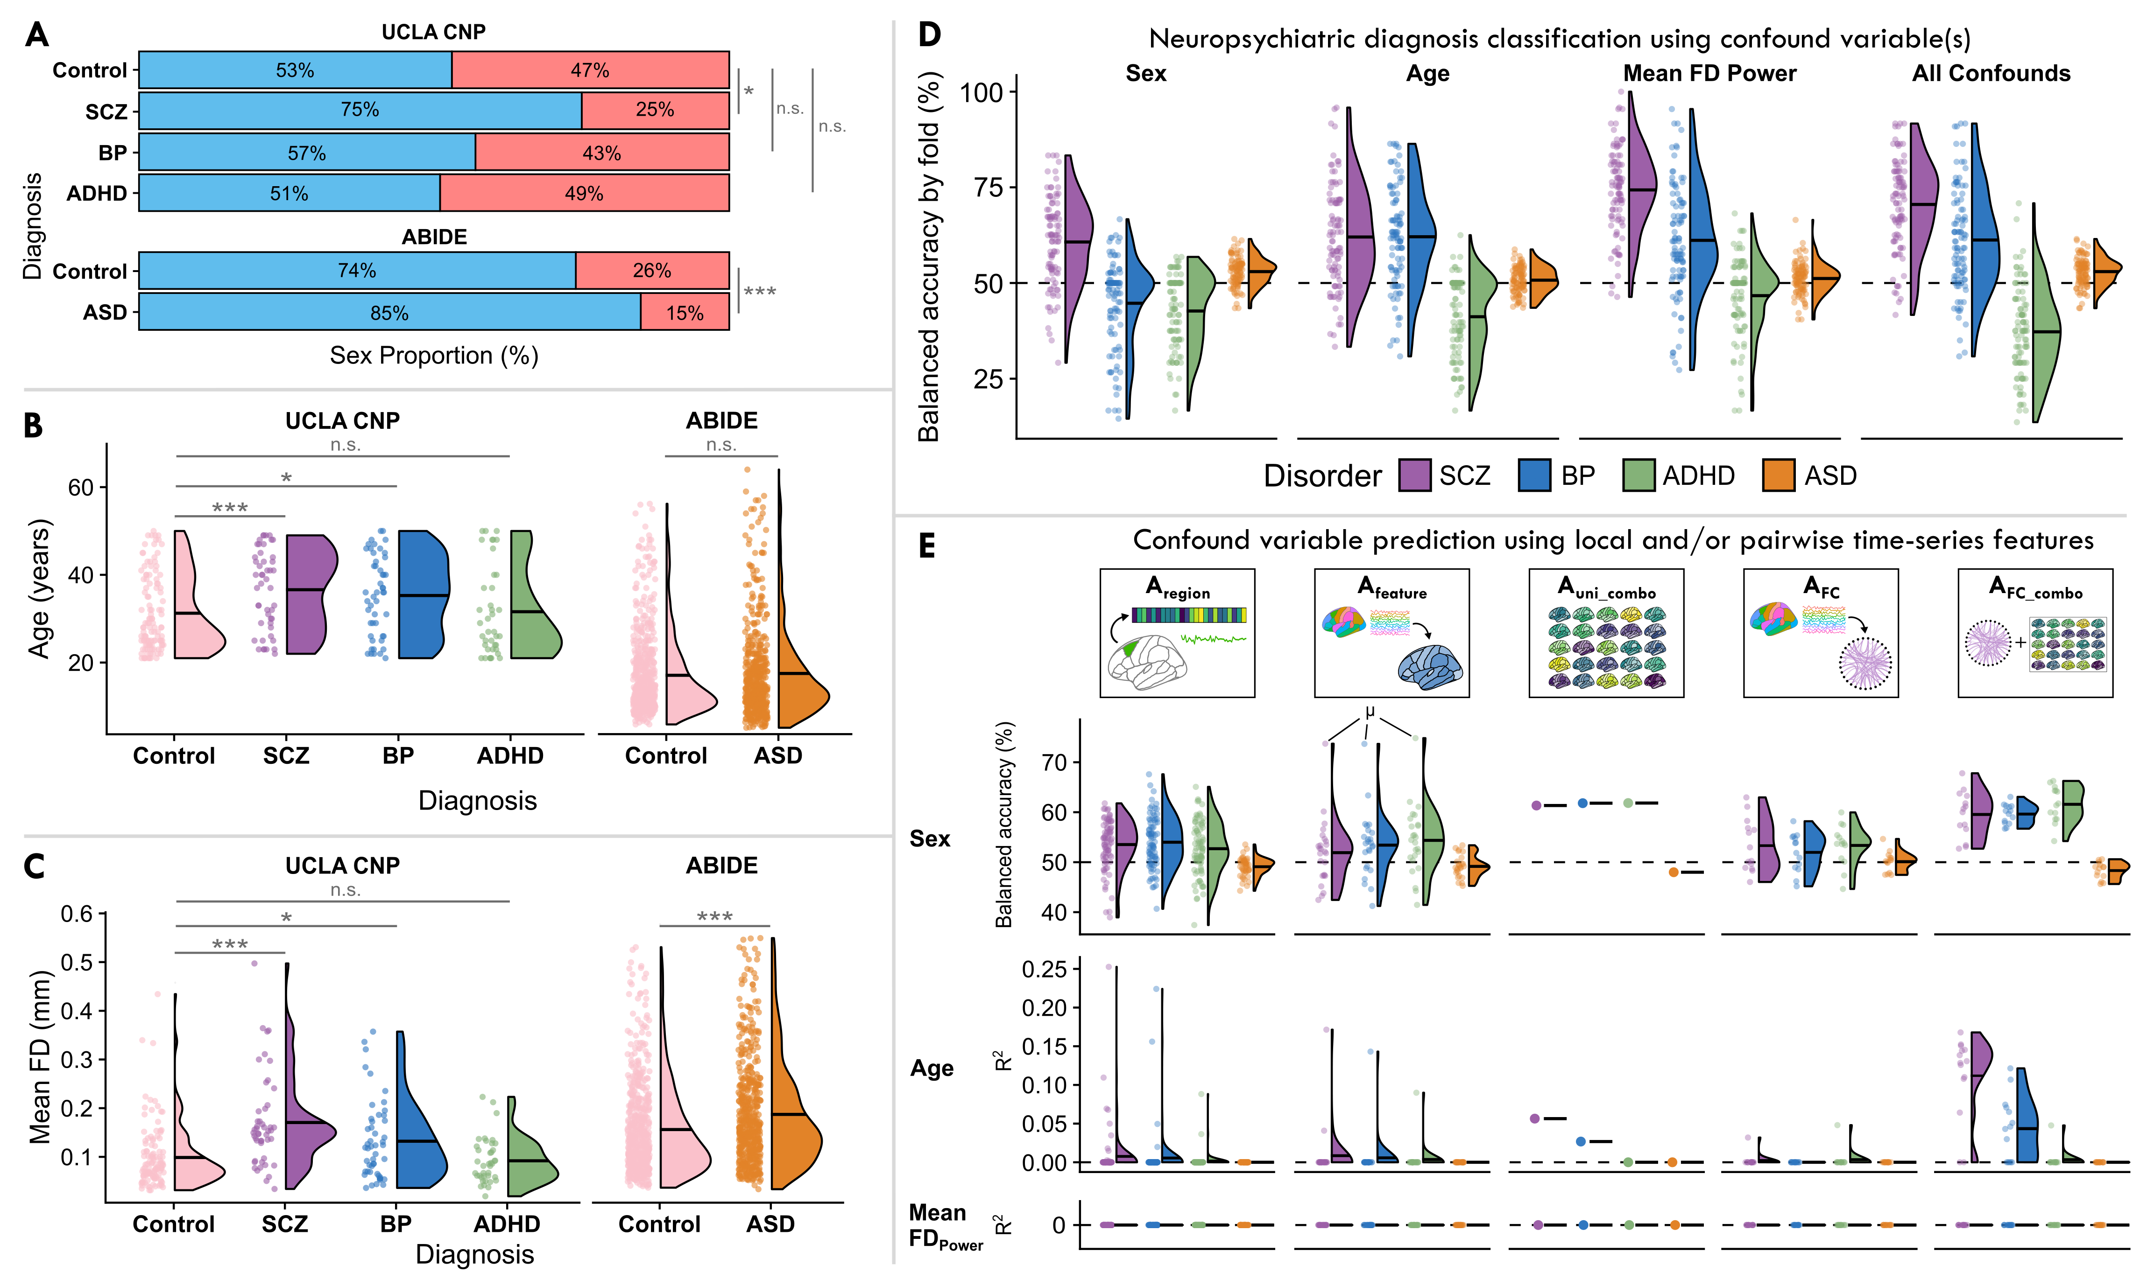
Fig 5?

Slide 6
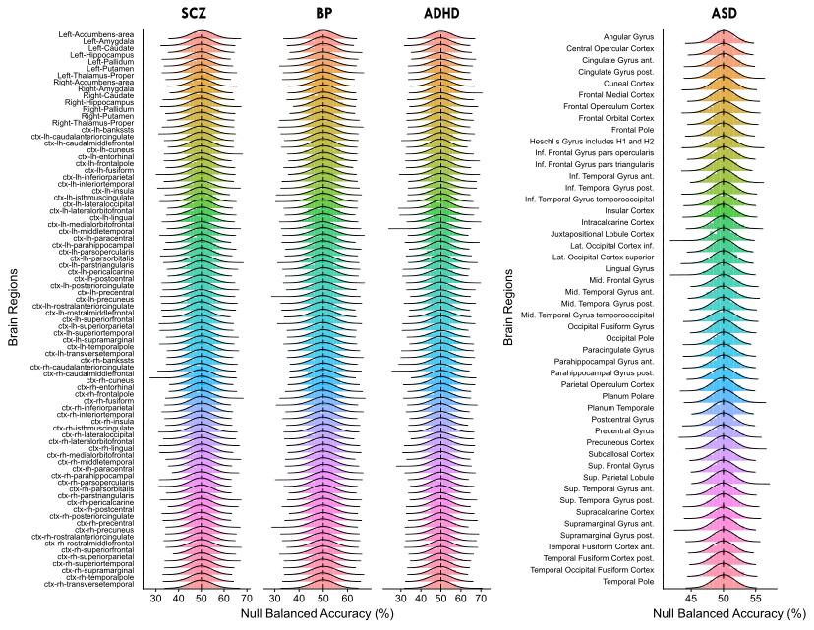
Fig S1

Slide 7
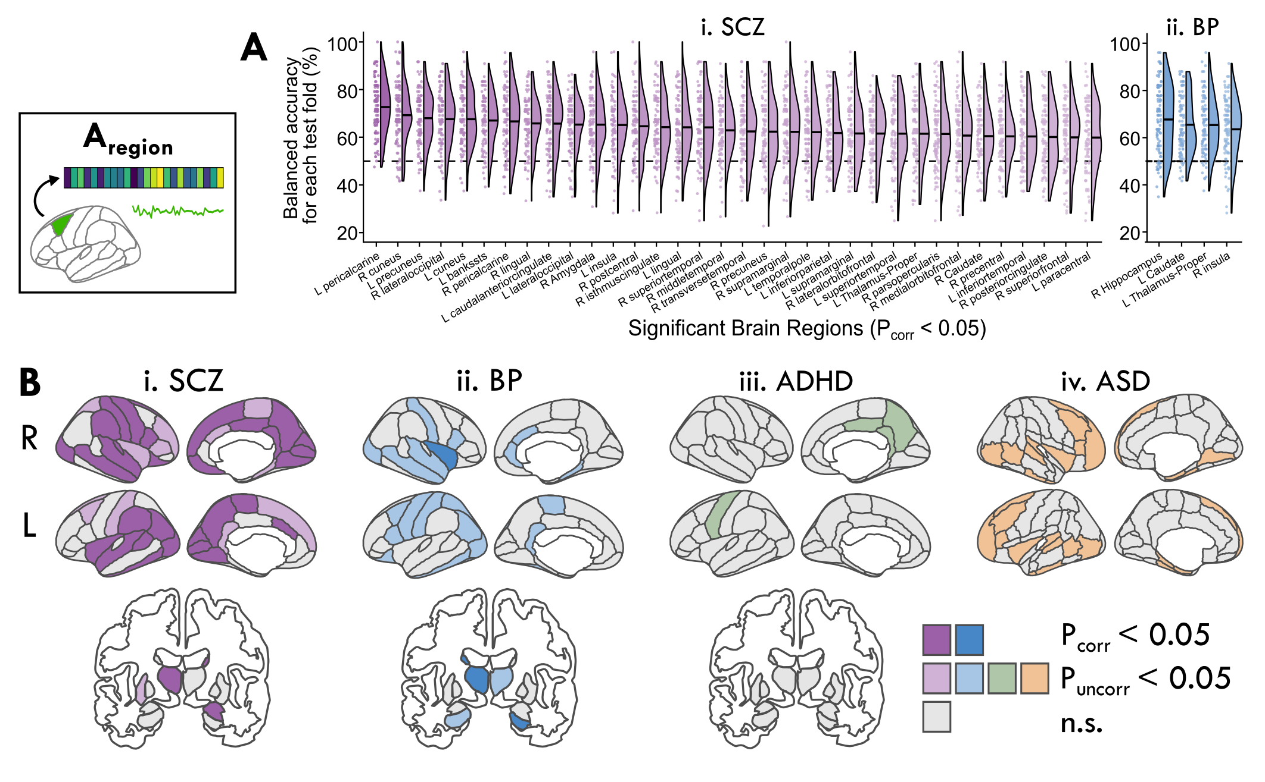
Fig S2

Slide 8
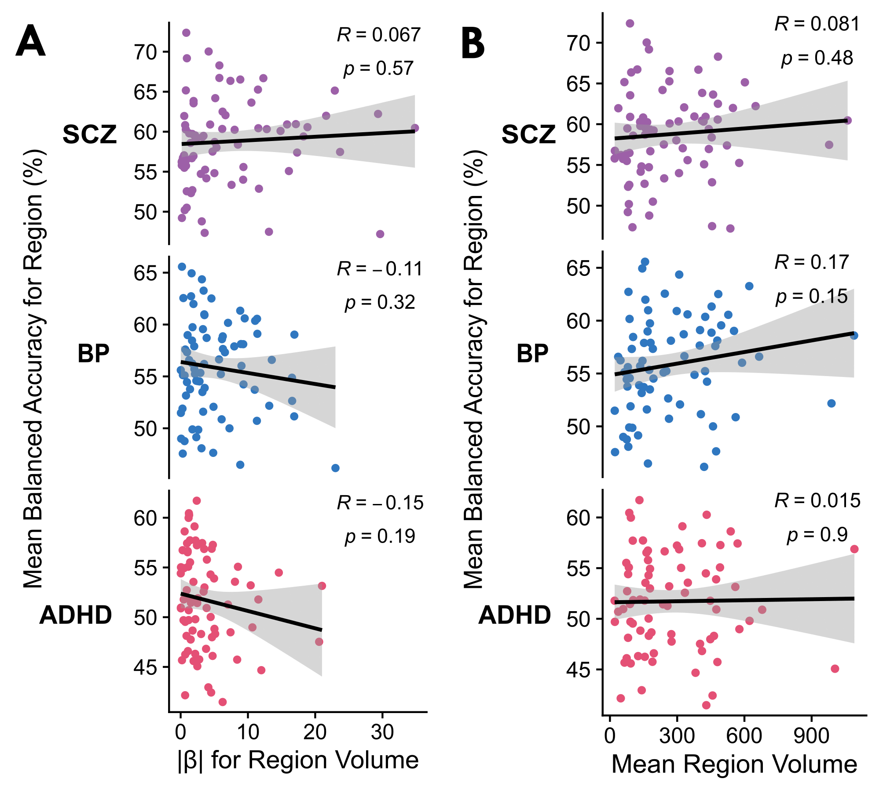
Fig S3

Slide 9
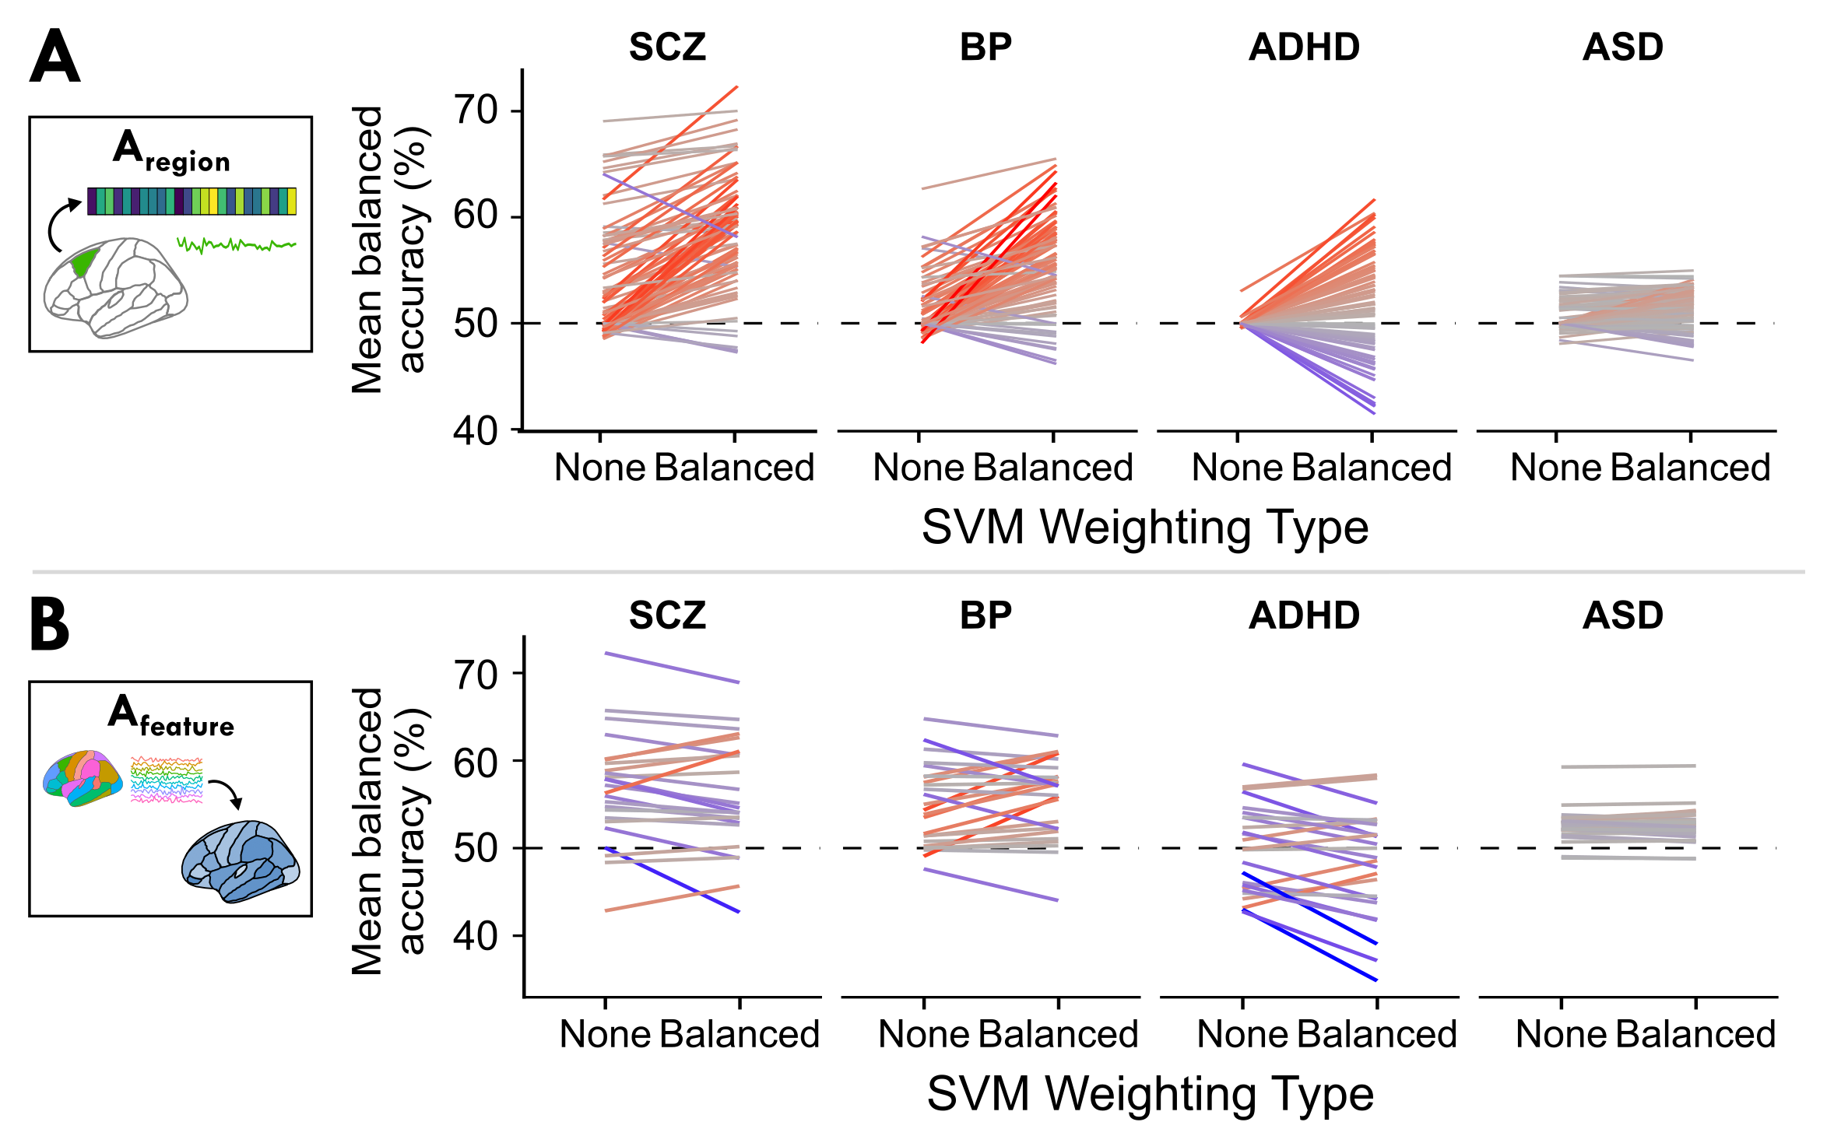
Fig S4

Slide 10
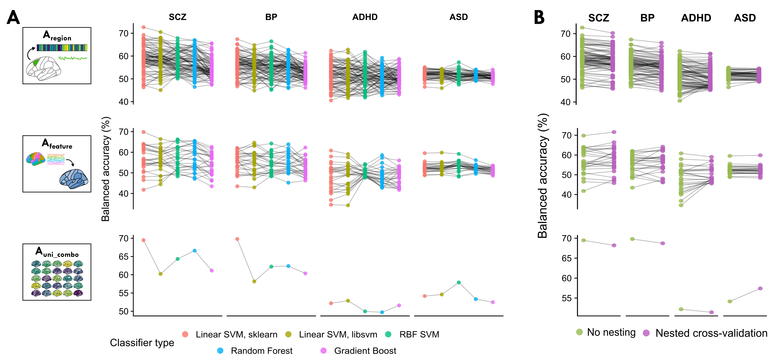
Fig S5

Slide 11
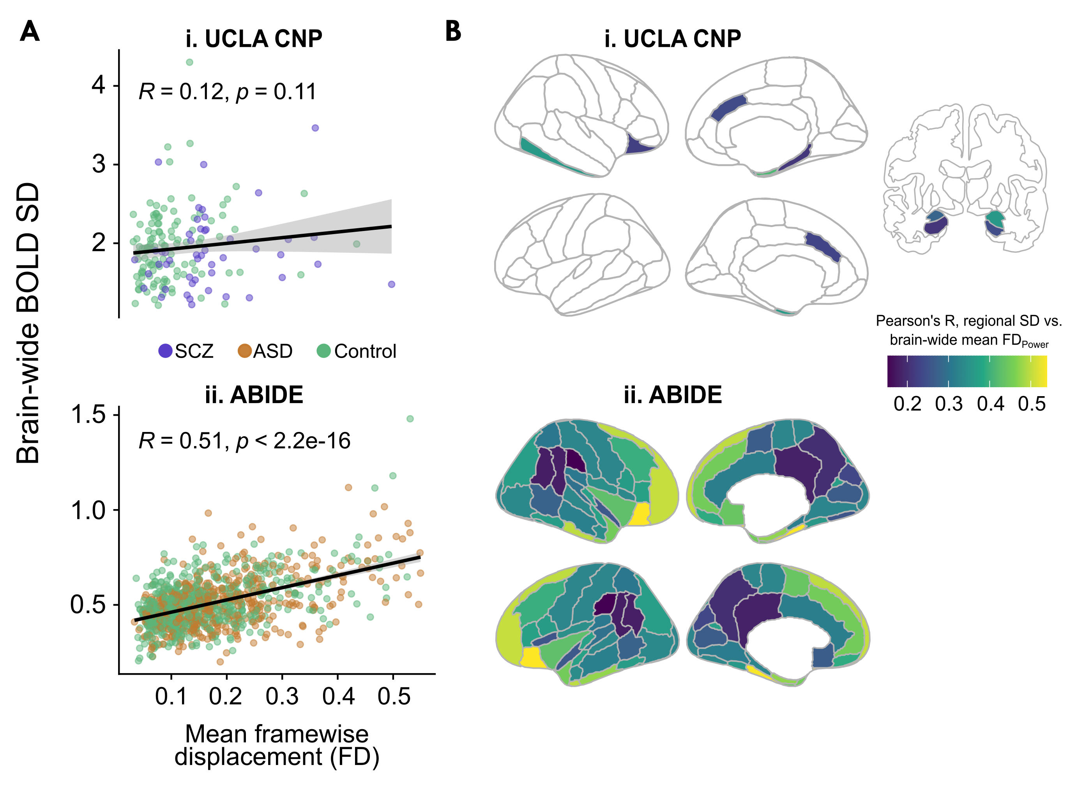
Fig S6

Slide 12
Fig S7
To update with more in-depth confound analyses: individual-site classification with ABIDE ASD

Slide 13
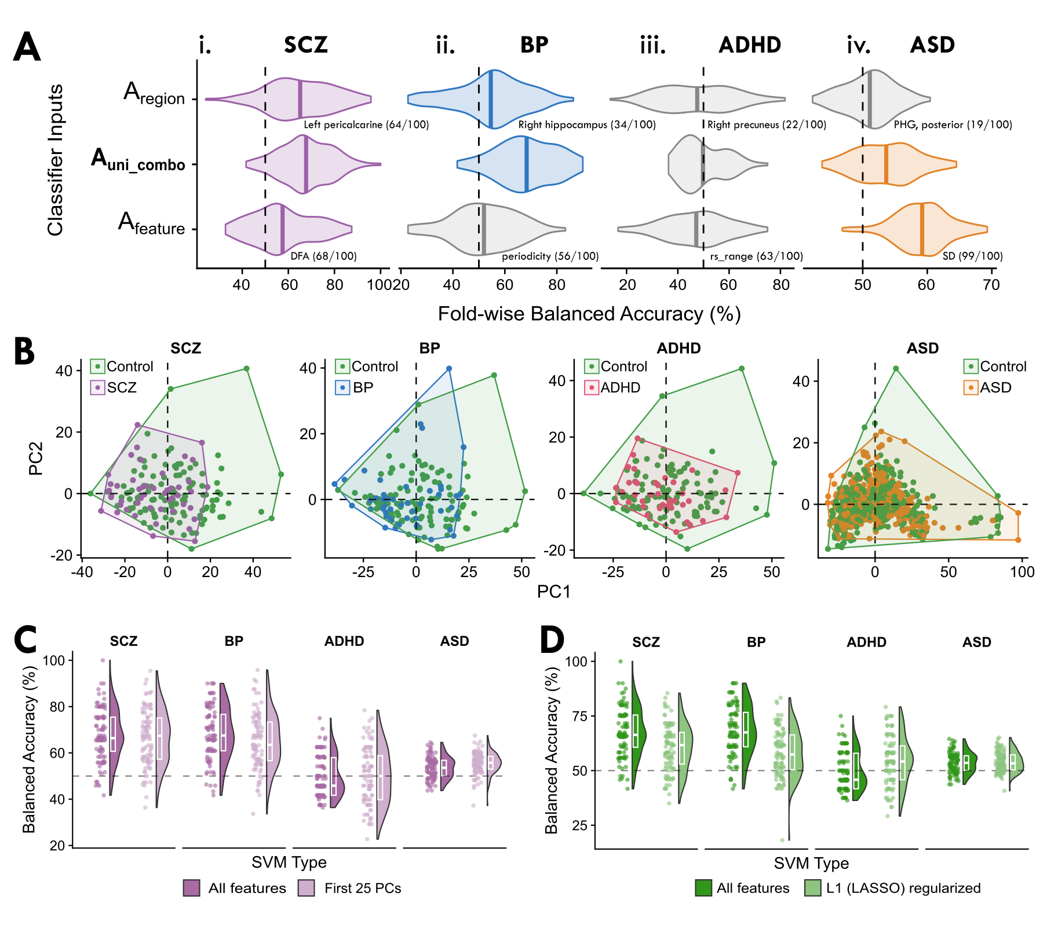
Fig S8

Slide 14
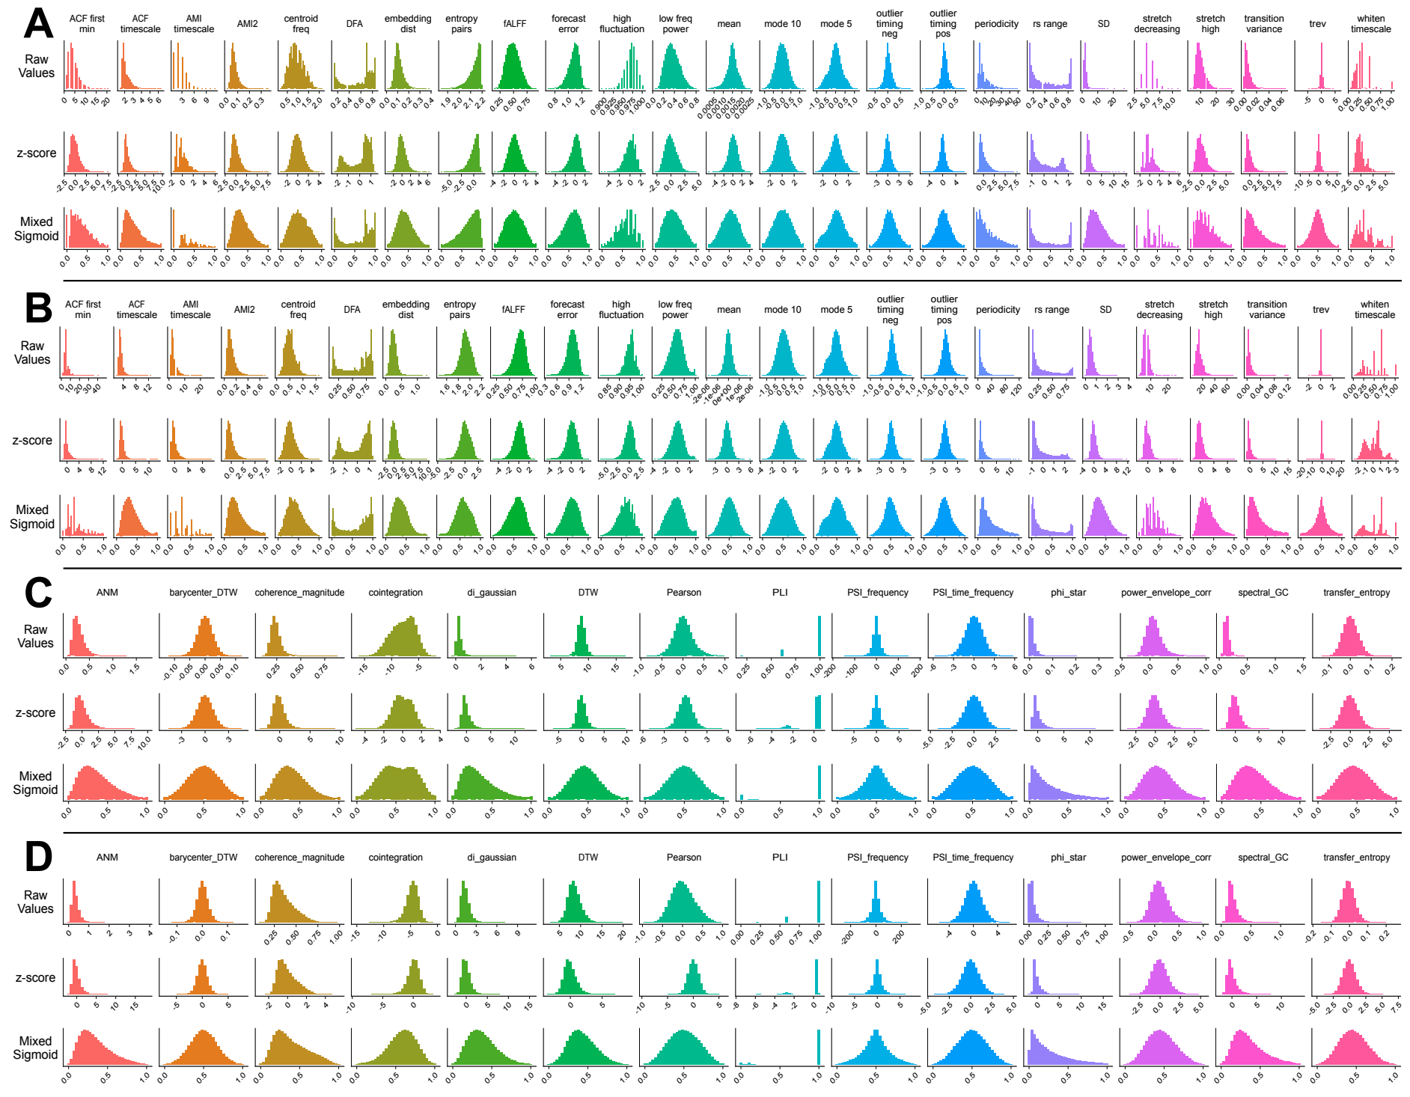
Fig S9

Slide 15
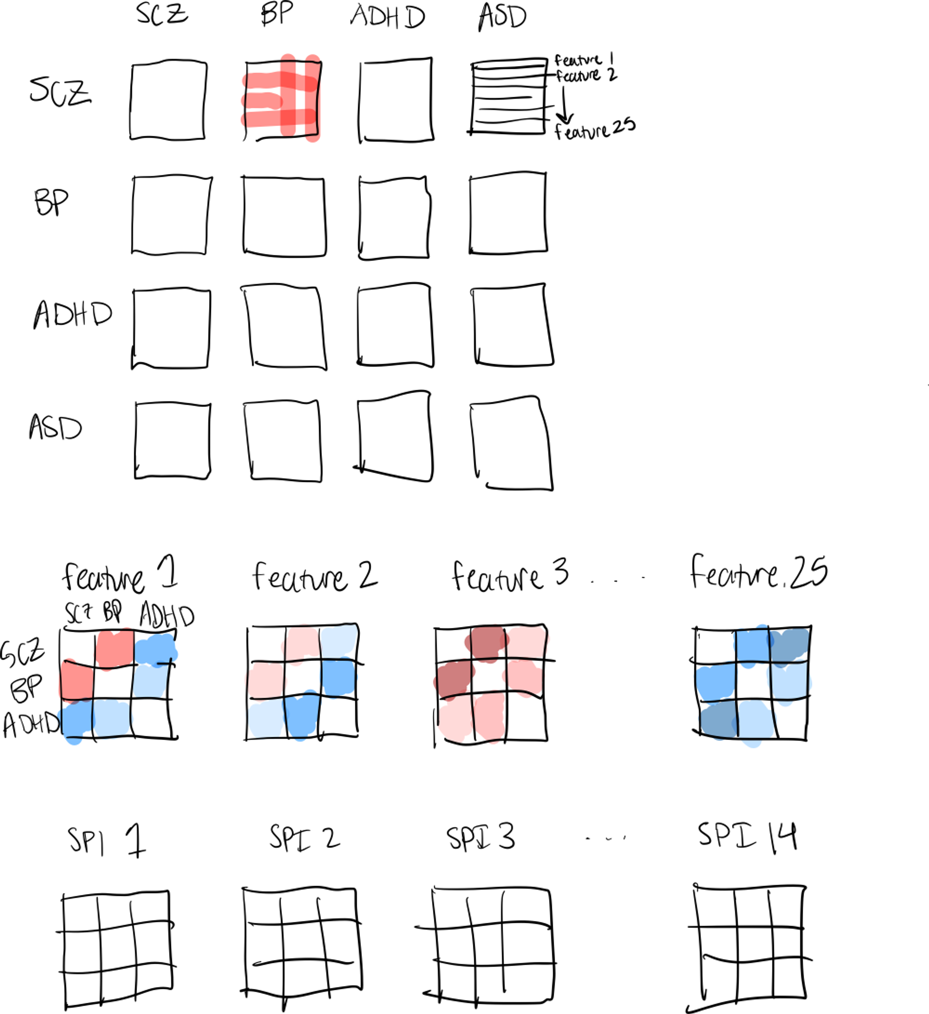
Fig ?

